Slide 1
State Feedback Control Law Design via Transformation to Control Canonical Form
Why transform to control canonical form?
What is the state feedback control law for the original non-transformed state-space system?
How to transform to control canonical form?

Slide 2
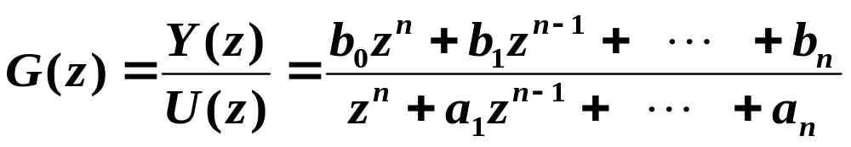




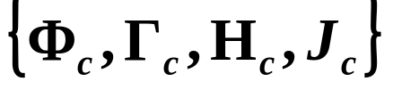
Transformation to Control Canonical Form
Given
Many state-space representations
Most “natural” state-space representation is one where states represent physical variables (position, velocity, temperature, etc.)
A representation that allows state feedback design to be very easily done is the control canonical form.

Slide 3
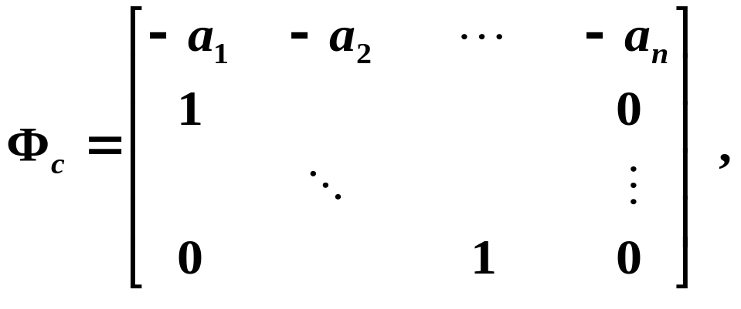
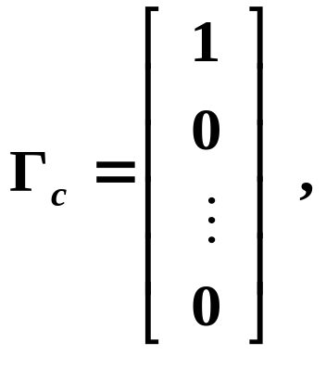


Control Canonical Form
If strictly proper:

Slide 4

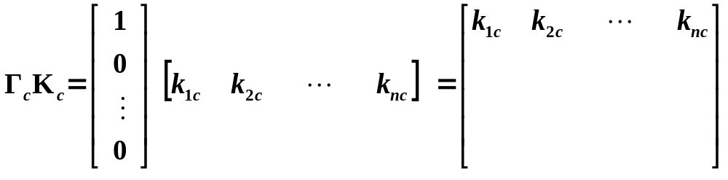
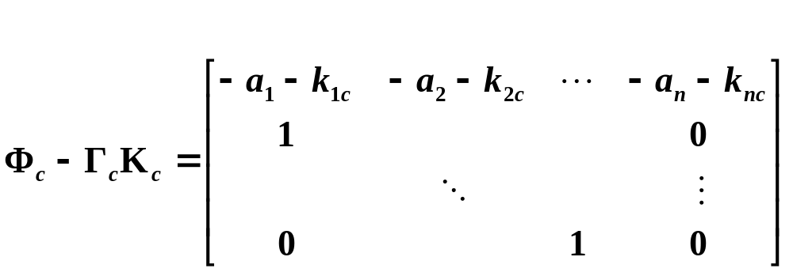
State Feedback Control of a System in Control Canonical Form
Closed-loop system matrix is

Slide 5
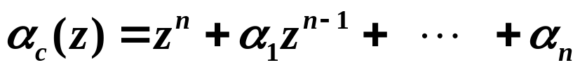
Actual closed-loop characteristic equation:
Desired characteristic equation:
Equating coefficients gives:

Slide 6

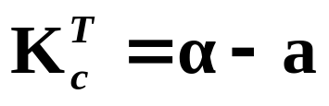
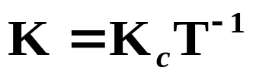
Summary of State Feedback Control Law Design via Transformation to Control Canonical Form
Now we have the feedback gain vector for control canonical form, but we want K for the original state representation.
Find T :
Feedback gain vector for control canonical form:
Transform it back:

Slide 7





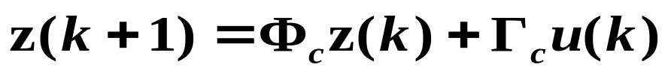


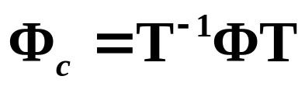
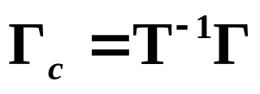
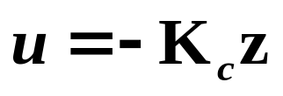



Slide 8



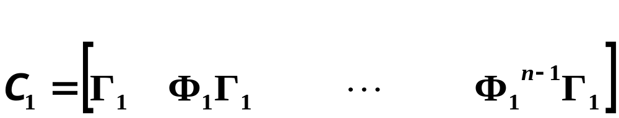


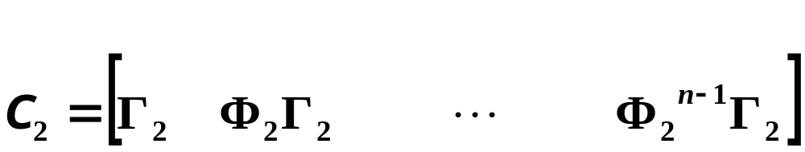



How do we determine the T to transform
the system to control canonical form?
First, does the transform affect controllability of a system?

Slide 9



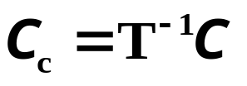
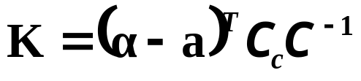
So for
Controllability is a continuous property:
While we have talked about systems as being either controllable or uncontrollable, controllability is not only a binary property. Some systems are more controllable than others. Some modes of a system are more controllable than others.

